Slide 1

Paint With Sound
Team 330 /
Jingwei Fan (jingweif)
Jing Xu (jxu2)
Sprint 1 presentation

Slide 2
Application Goal & Design
Transform sound into images.
Light-weighted social function(Not our focus!).
Three modes
Real-time image generation according to microphone input
More complicated & styled image generated from user-uploaded audio file
Image selection combining simple speech analysis

Slide 3
Path for Mode1 Implementation
Straight-forward 2-phase thinking
Extract data from audio input
Generate image using the extracted data
Real-time feedback
No complicated calculation, the generated images are relatively simple
Focus mainly on front-end
Utilize JS library to achieve our goal
Web Audio API – record microphone input and extract data
D3.js – Visualize data and display

Slide 4
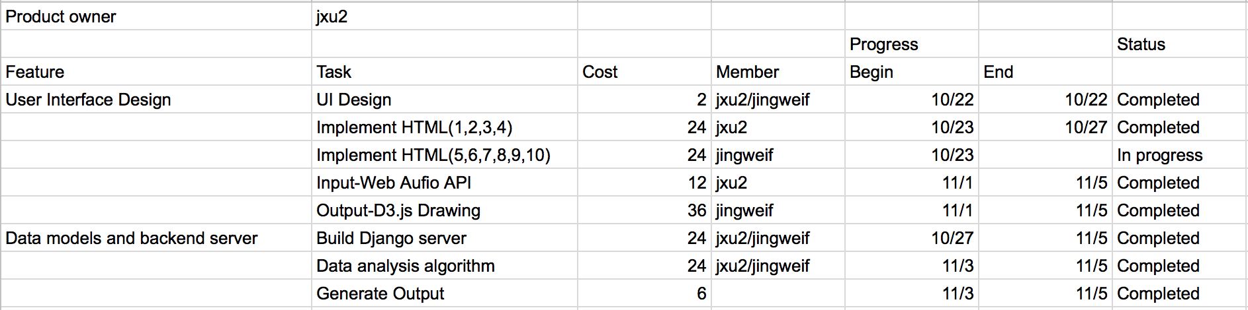
Sprint 1

Slide 5
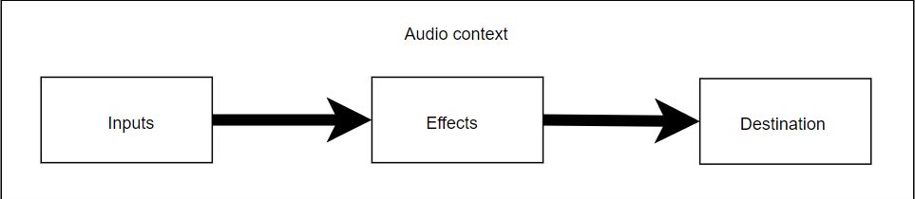
Sound to Data: Web Audio API
Audio Routing Graph
Audio operations are handling inside an audio context
Basic audio operations are performed with audio nodes
Audio nodes are linked to form a audio routing graph

Slide 6
Sound to Data: Web Audio API
Source of the ARG: audio stream input through microphone
Destination of the ARG: currently output device (will be saved to server)
User analyserNode to extract data
Current frequency data of the audio stream
Current waveform, or time-domain data, of the audio stream
Use convolverNode to create more audio data
Conduct a convolution on the original audio stream, then grab the frequency and the waveform data of the processed audio stream.

Slide 7
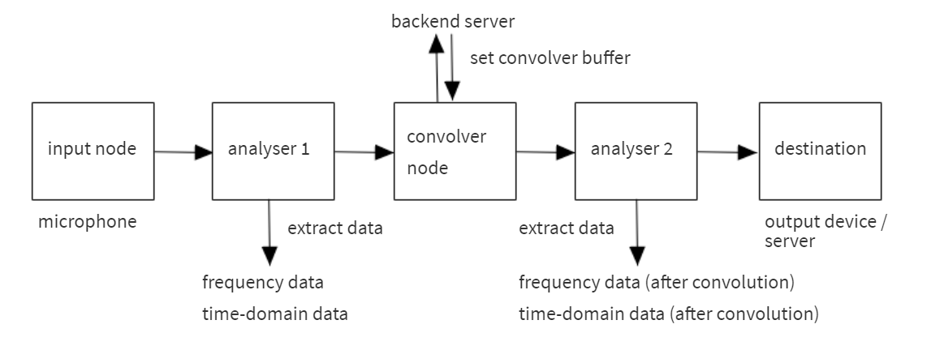
Sound to Data: Web Audio API

Slide 8
XMLHttpRequest
“XMLHttpRequest is the core of Ajax.”
XMLHttpRequest can be used to retrieve any kind of data, not just XML.
The source of the AudioBuffer used for convolution is retrieved from the server through an XMLHttpRequest.
url: /get_conv_audio/

Slide 9
Data to Image: D3.js
Data Virtualization
“D3.js is a JavaScript library for manipulating documents based on data. D3 helps you bring data to life using HTML, SVG, and CSS. ”
HTML5 :
CANVAS (2D Bitmap):
SVG (Scalable Vector Graphics):

Slide 10
Data to Image: D3.js
Animation:
Stack
Streamgraph
D3.transmition()
D3. duration()
D3.ease()
D3.delay()
…

Slide 11
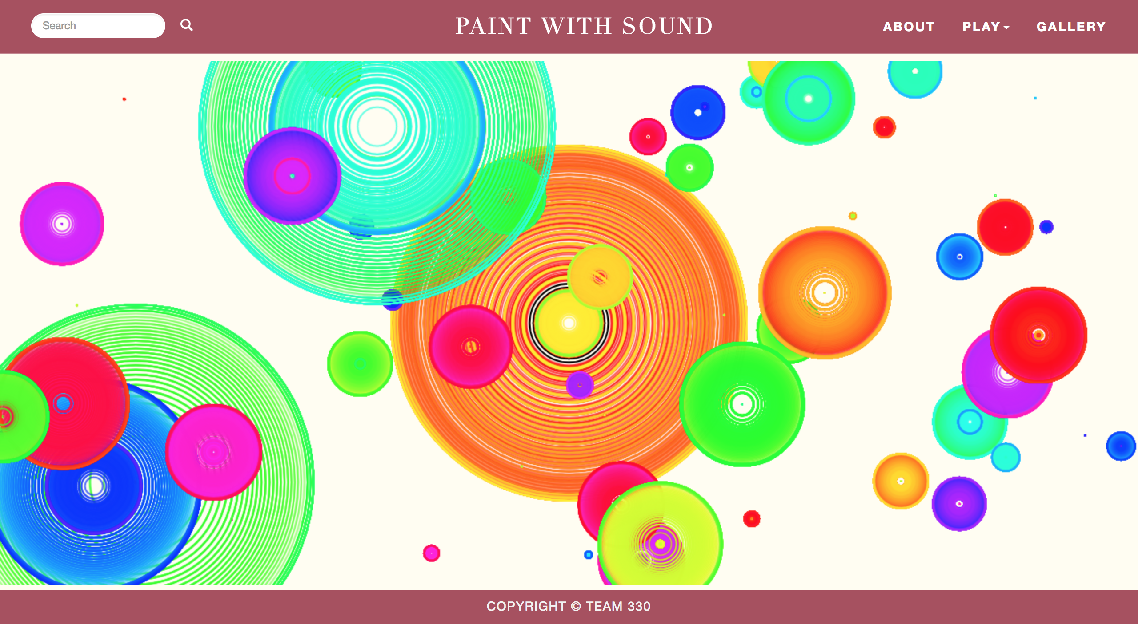
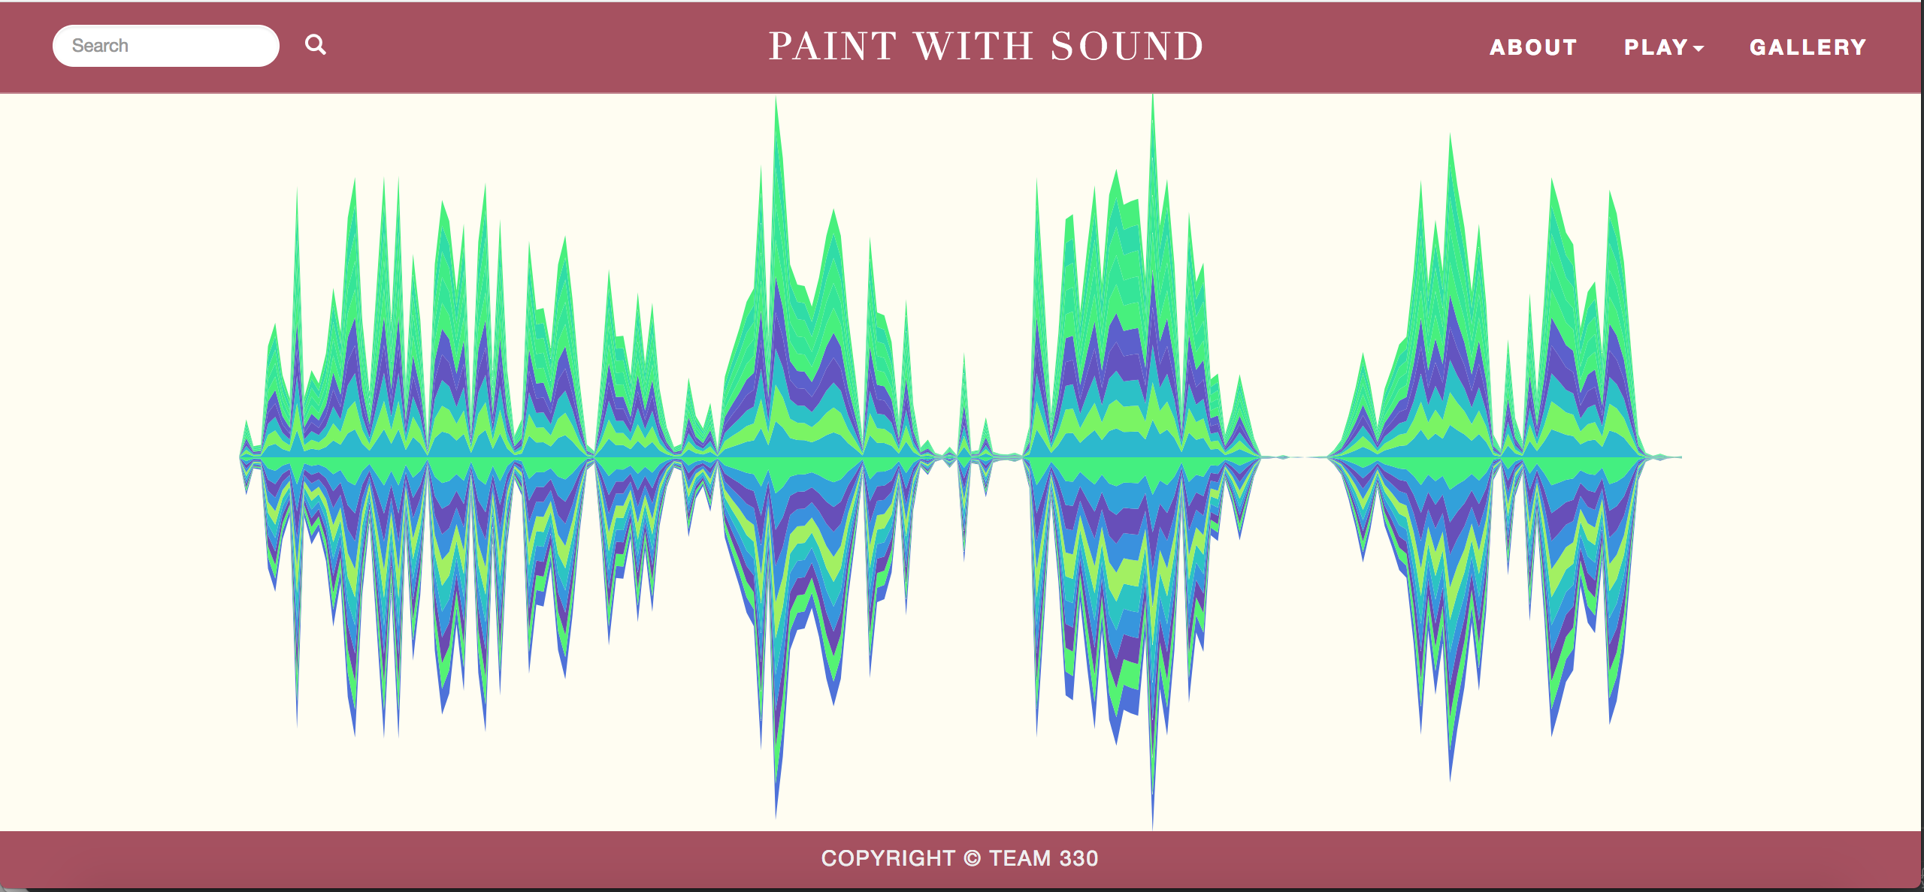
Demo Presentation
Notes:
Add a generated image here

Slide 12
Problem & Reflection in Sprint 1
Work left to be done:
We are kind of fall behind our original schedule.
Add more patterns for image generating.
Limit the length of user input audio stream.
Save image and audio for user.
For next sprint:
Fix the problems ASAP
Implement the second mode
Backlog can be divided more specifically

